Slide 1
DMART SALES PREDICTION
PRESENTED BY:-
SIDDHARTH SINGH

Slide 2

Problem Statement
To predict Sales Revenue
Perceive Challenge Early
Aid Future Marketing Plans
Plan Recruiting Strategy
Motivate Sales Teams

Slide 3
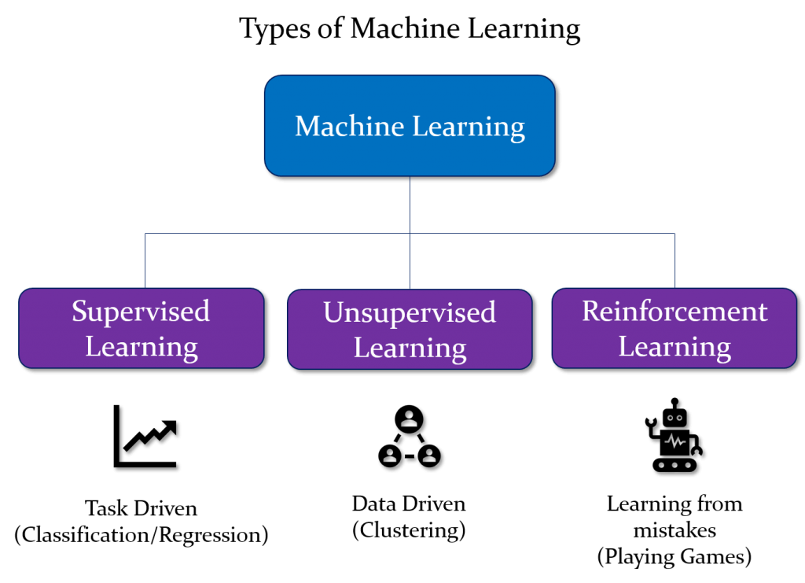
Types of machine learning

Slide 4
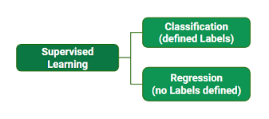
Supervised learning

Slide 5
Work flow
.
Data
Data Preprocessing
Data Analysis
Evaluation
Modelling
Train Test Split

Slide 6
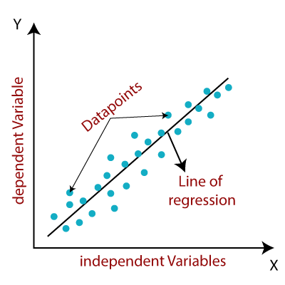
Linear Regression

Slide 7
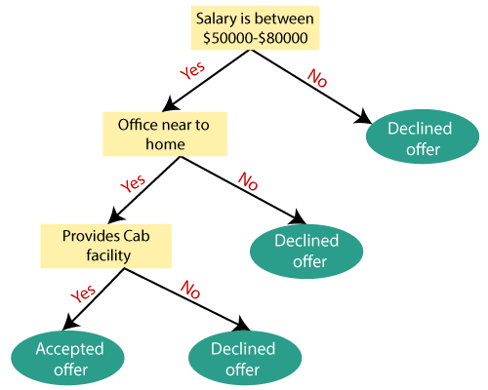
Decision tree

Slide 8

Support vector machine

Slide 9
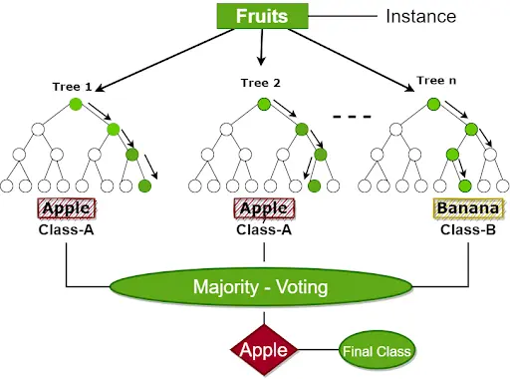
Random forest

Slide 10
conclusion
As per the analysis……

Slide 11
THANKYOU

